Slide 1
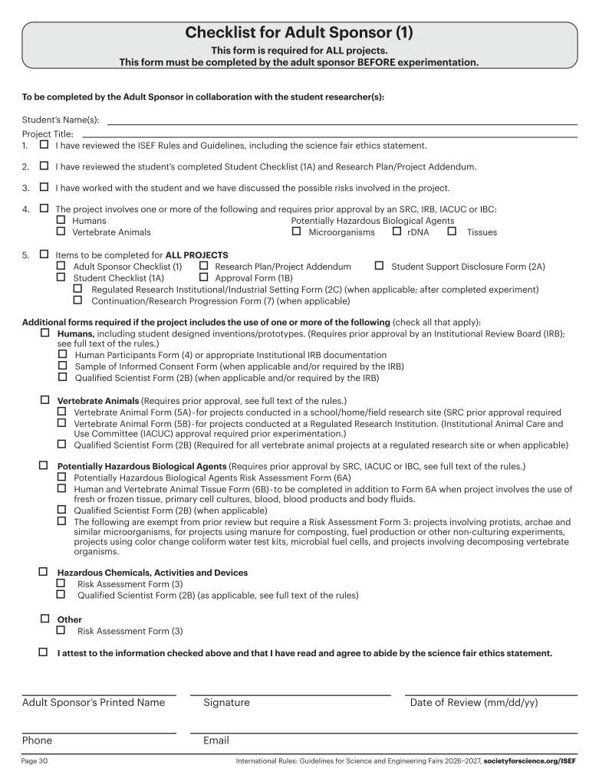
Fit as much of the title as possible.
Keep titles as short as possible.
Only check boxes that are appropriate to this research study.
Only check boxes that are appropriate to this research study.
This must be dated BEFORE the “Actual Start Date” on Form 1A
This is usually the research teacher
NOT the project mentor if there is one.

Slide 2
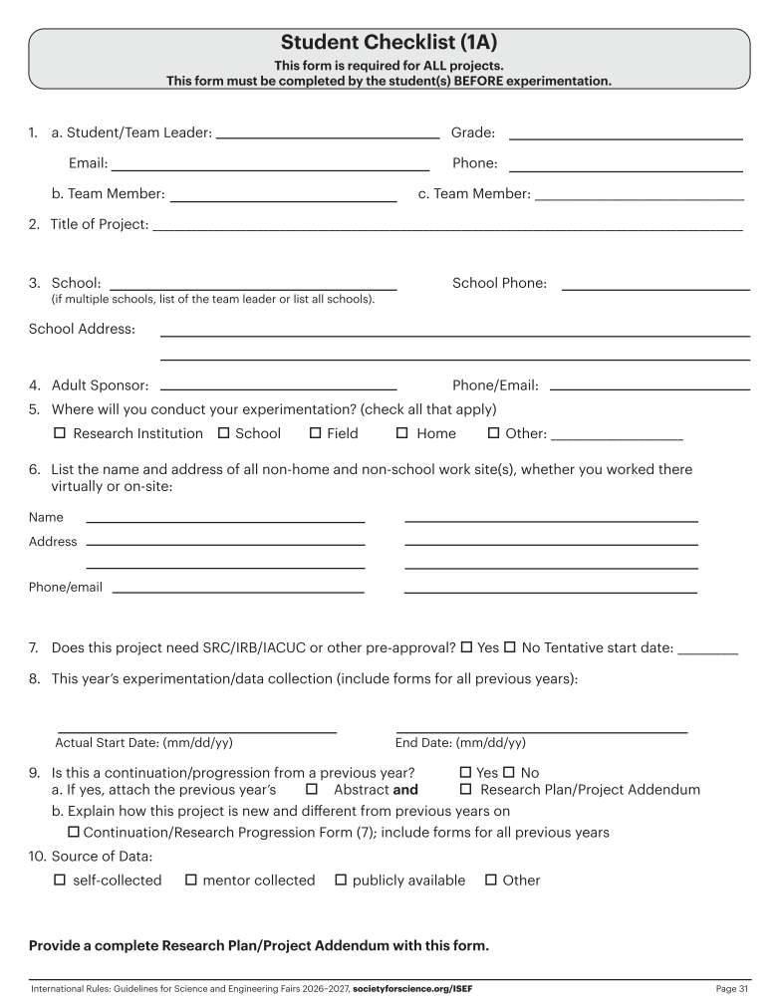
Fit as much of the title as possible.
This should be the TEACHER not the mentor.
The date the student started collecting data
IF the student has continued the project, the poster MUST focus on the work from the current ISEF year’s published time frame.

Slide 3
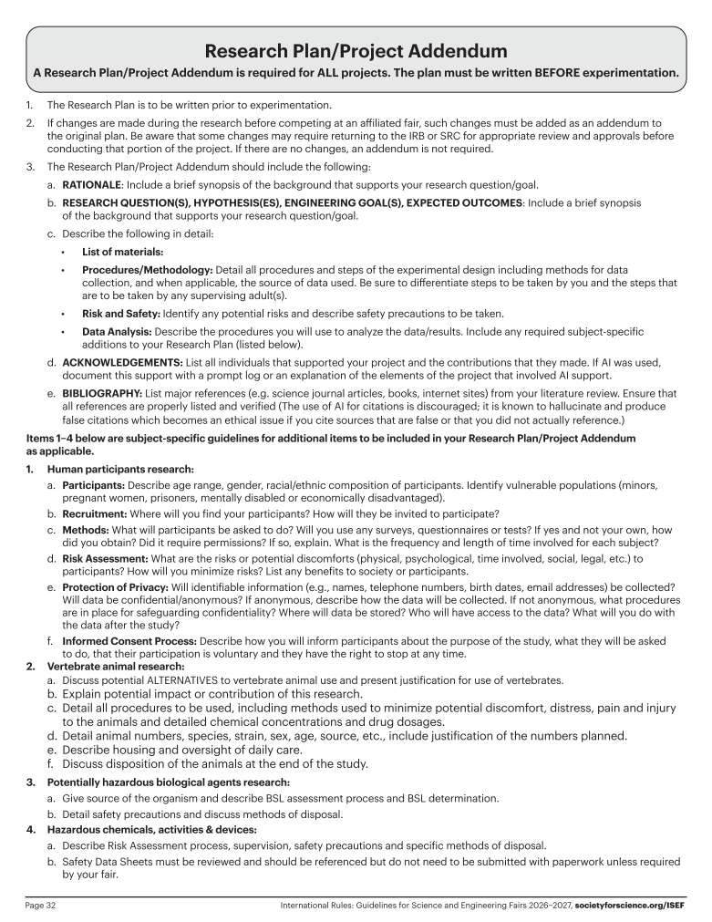
This is a new section that must be filled out explaining any help that the student WILL receive including from AI.
The research plan is the most important document because it provides the regional SRC/IRB committee the necessary details of the planned research.
This detailed description of the research guides the SRC/IRB to be able to determine if the proper forms were completed and if they contain the correct information.
MUST be VERY detailed and clearly delineate the role of the student vs. the role of any mentors or other researchers.
The entire RP MUST be in FUTURE tense!!
Protocol forms packet must include tentative and actual start dates (1A), a detailed research plan, all work site information (1A & other forms as indicated), and clear identification of the student and mentor roles.
** See Examples in the ASRT Booklet and in the ASRT Digital Folder “COMPETITIONS (Info and Forms)”
Page 33

Slide 4
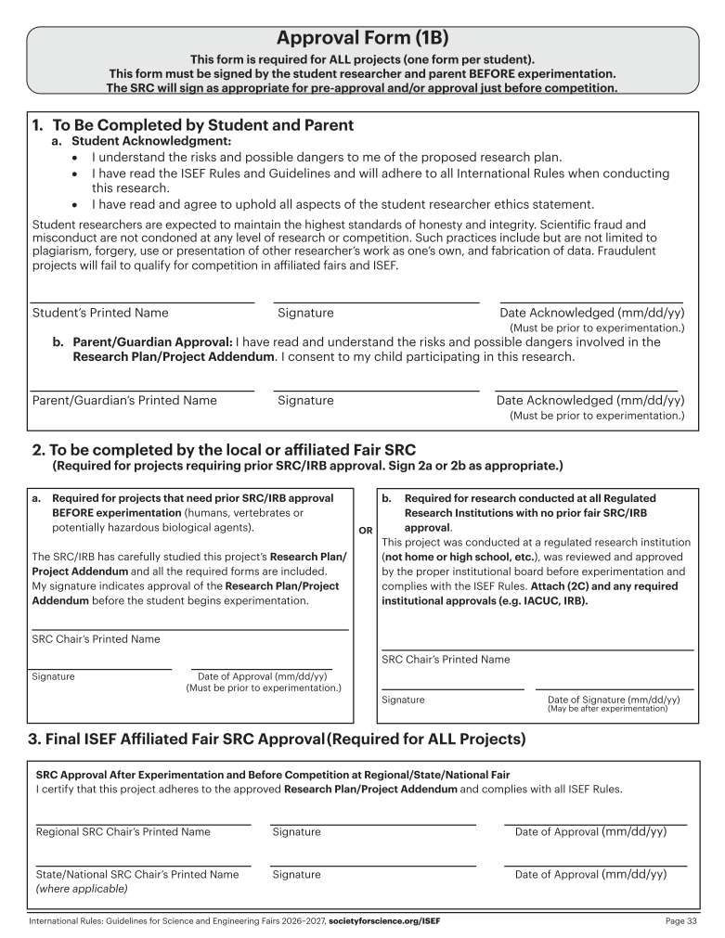
This MUST be dated BEFORE the “Actual Start Date” on Form 1A
This MUST be dated BEFORE the “Actual Start Date” on Form 1A
DO NOT write anything
In this space unless you
Are the SRC/IRB Chair or
their Designee.
DO NOT write
anything in this
space.
DO NOT write
anything in this
space.

Slide 5
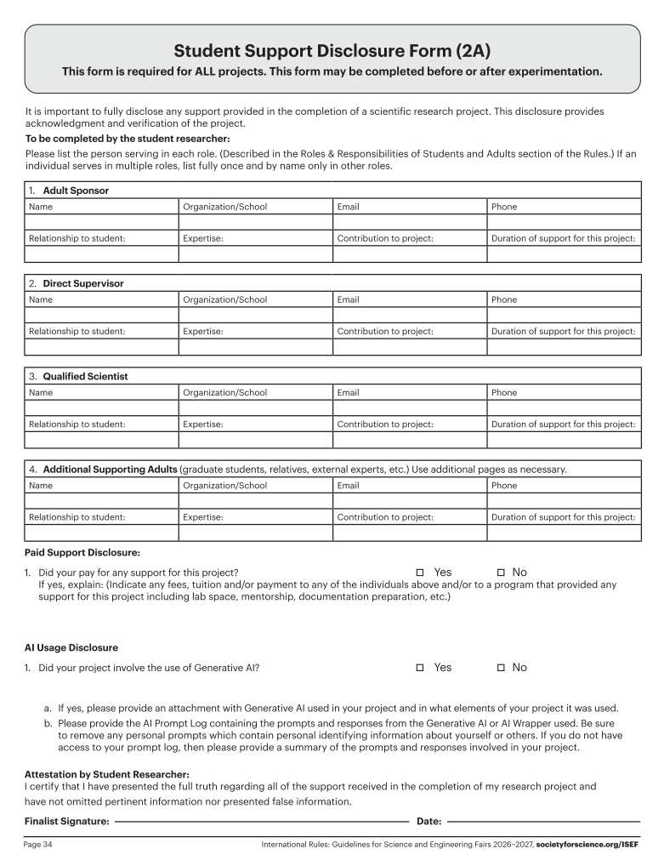
This is usually the research teacher . NOT the project mentor if there is one.
This is usually the scientific mentor. NOT the teacher.
This may be a lab scientist if the main scientific mentor did not directly supervise the student
This is new as of 2027
This is new as of 2027

Slide 6
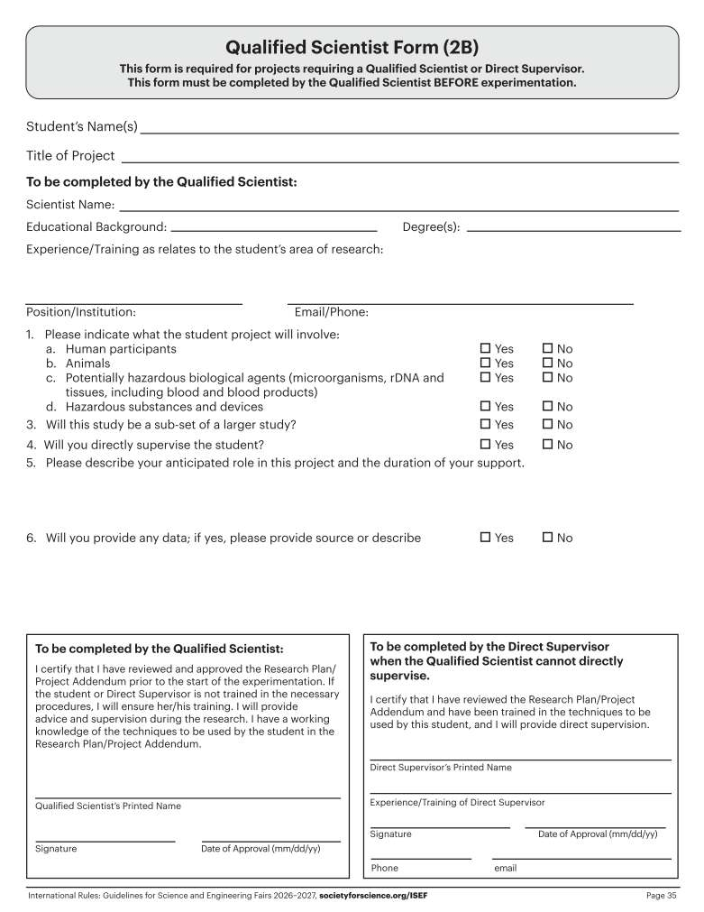
The information on this form will supplement the research plan/proposal.
All information on this form should be in future tense
This should be the MENTOR and NOT the teacher.
This MUST be dated BEFORE the “Actual Start Date” on Form 1A.

Slide 7
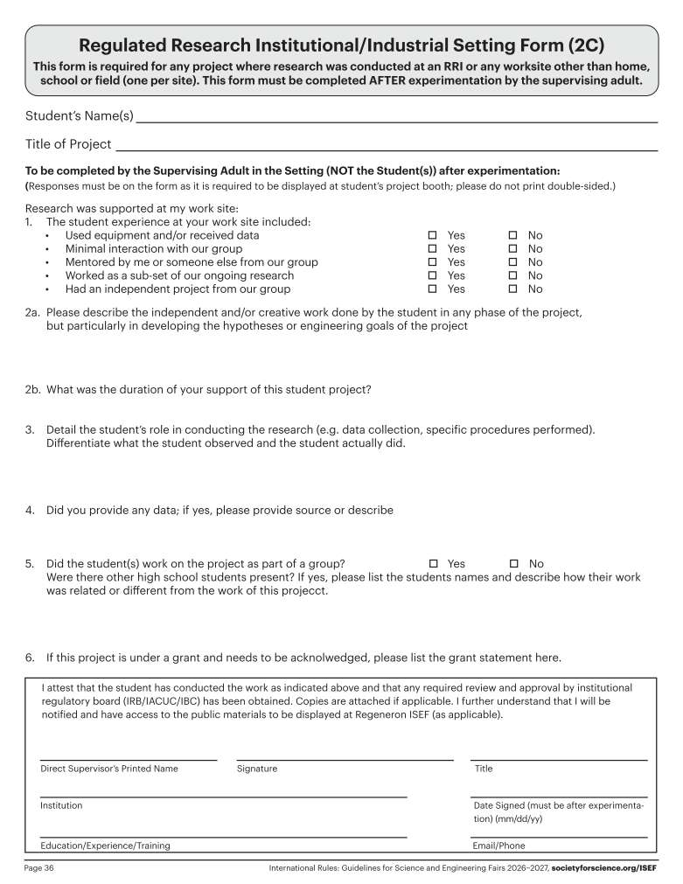
-If any of the research was done at a standard research facility (college, pharmaceutical company, environmental test facility, etc.) or a facility where advanced research is allowed (certain high schools or local labs), the Form 1C is REQUIRED!
- If the project is to be a data analysis only AND the data is publicly available, then nothing else is needed.
-If data is covered by privacy rules/laws (ex: patient data) or from a private source (ex: proprietary data), the student MUST show documentation of how the data became available and how/why they were allowed to view it and study or analyze it.
**The best thing to do is have the mentor/designated supervisor from the source organization send a short letter on their letterhead explaining that there were no HIPAA violations. This is even if the data has been de-identified.
This should be the MENTOR and NOT the teacher.
This MUST be dated AFTER the “End Date” on Form 1A.

Slide 8
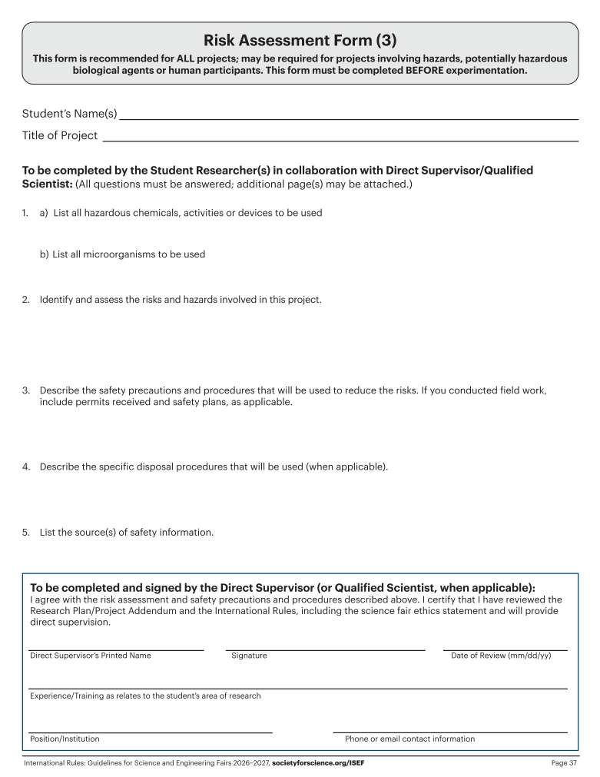
This MUST be dated BEFORE the
“Actual Start Date” on Form 1A

Slide 9
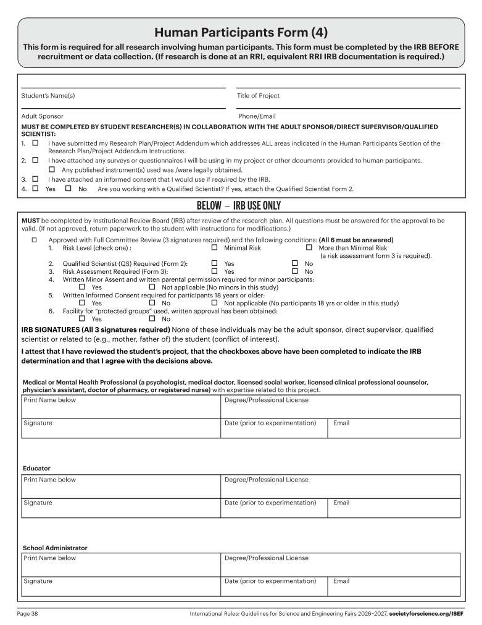
Even though your school IRB may have given approval, the study MUST conform to ALL ISEF rules/requirements.
This is usually the research teacher
This form is to be filled out by the IRB reviewing the project for prior approval (school, regional). However, if it is your school IRB, be sure they are award of the rules and limitations of student research projects as published in the ISEF rules. For more information and the full list of rules:
https://sspcdn.blob.core.windows.net/files/Documents/SEP/ISEF/2025/Rules/Book.pdf
This CANNOT be the same teacher that signed as the “Adult Sponsor”
These must be dated BEFORE the “Actual Start Date” on Form 1A

Slide 10
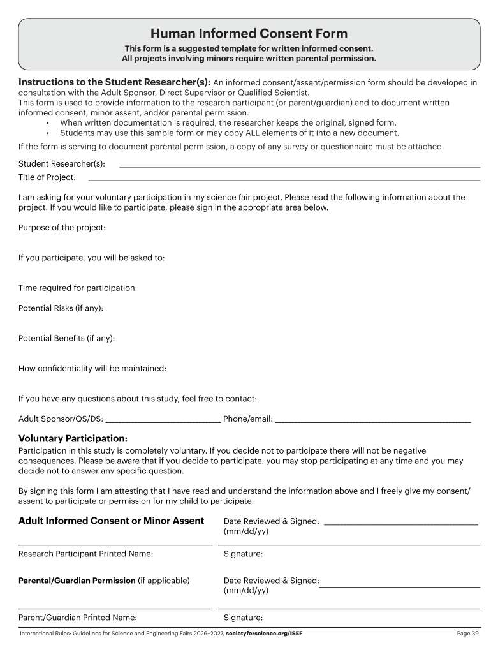
This is just an example of a consent form, though if filled out in detail may be used as the official Informed Consent for the project. If a survey was done online, submit a copy of ALL of the consent questions used as part of that survey. You MUST submit a copy of whatever consent form is going to be used. If the project involves a survey instrument, that survey MUST be included with the protocol paperwork for IRB review.

Slide 11
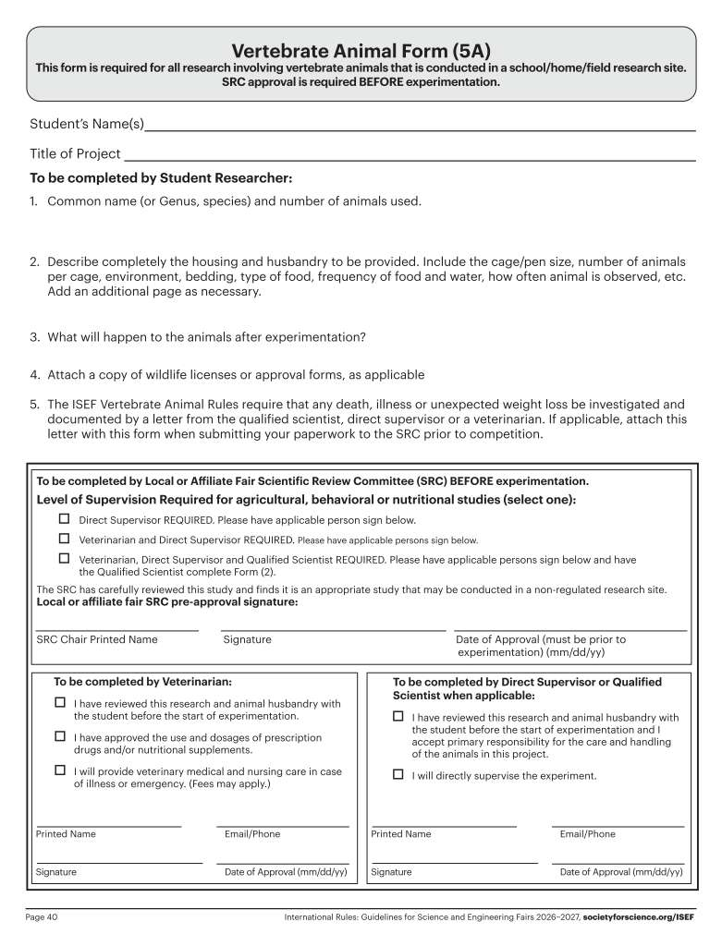
This MUST be dated BEFORE the “Actual Start Date” on Form 1A
This MUST be dated BEFORE the “Actual Start Date” on Form 1A

Slide 12
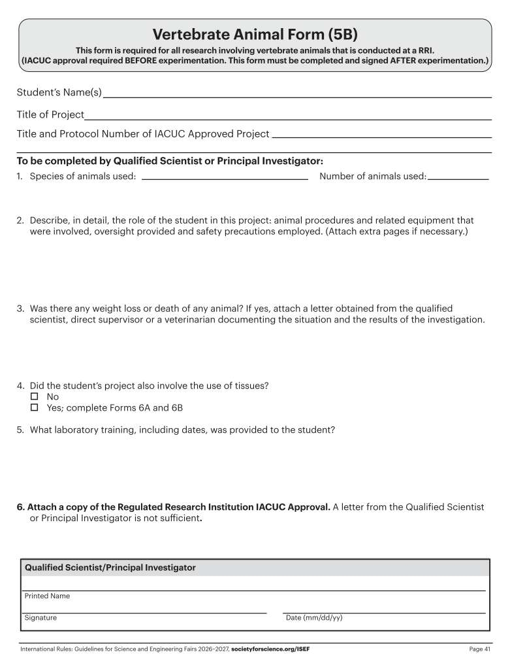
You MUST include a copy of the actual IACUC form with the protocol number
This MUST be dated AFTER the “End Date” on Form 1A

Slide 13
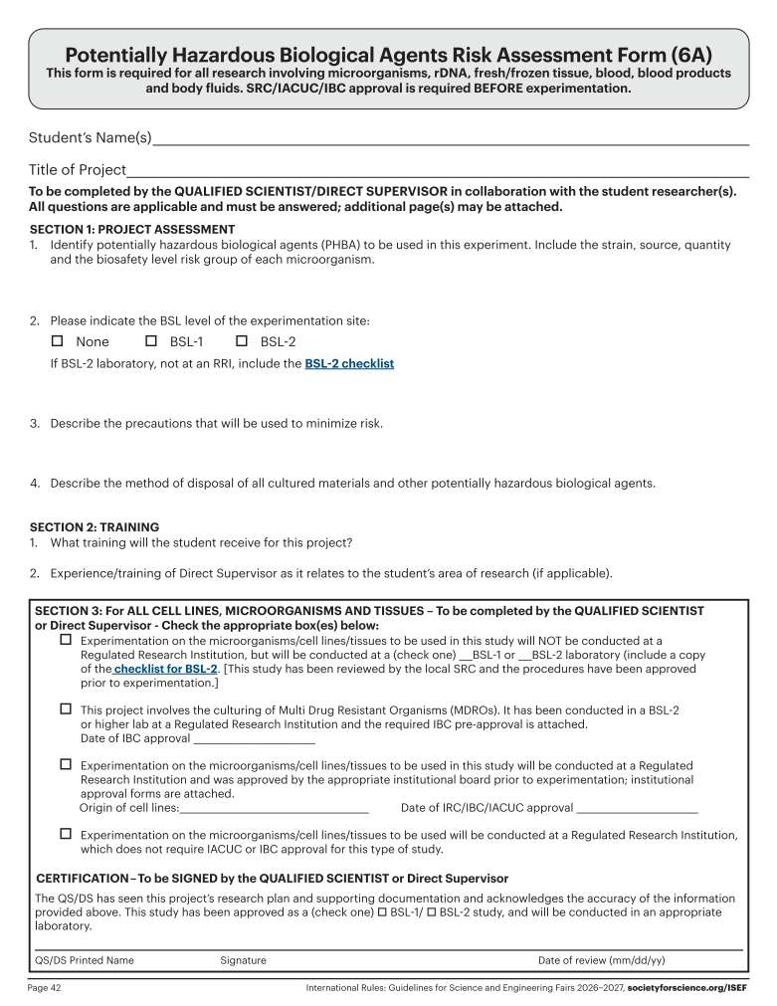
This MUST be dated BEFORE the “Actual Start Date” on Form 1A
DO NOT write
anything in this space.

Slide 14
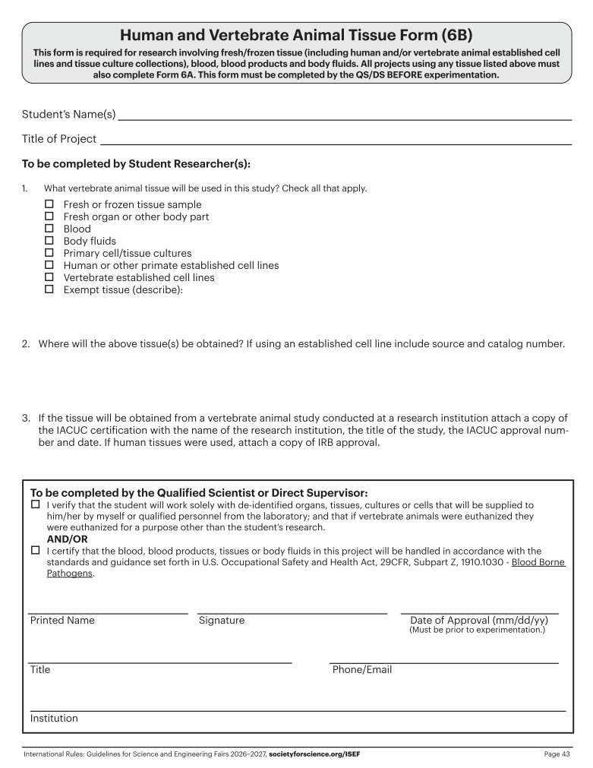
This
MUST be dated BEFORE
the “Actual Start Date” on Form 1A

Slide 15
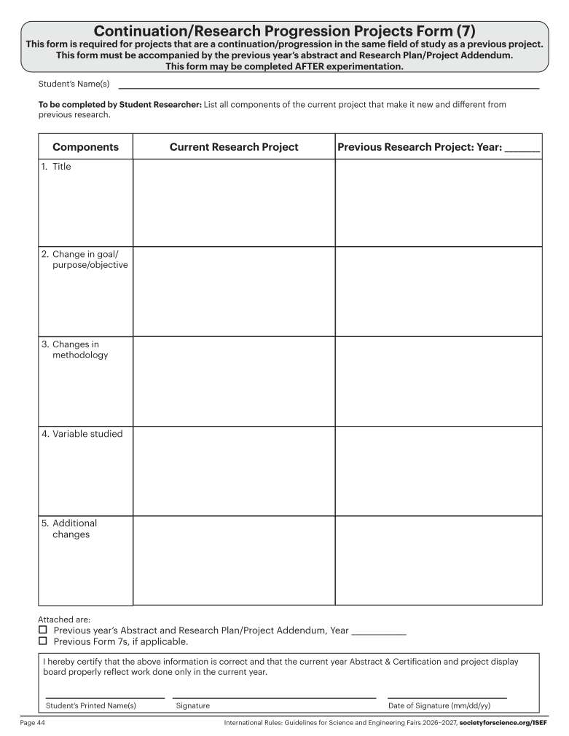
Continuation projects MUST include this form. For the immediately prior year, the student researcher MUST include BOTH the
Abstract & Research Plan.
For any years farther back, the researcher MUST include the Abstract and Research Plan for each additional prior year’s work in comparison to the current year’s work.

